Slide 1

NEXT HIKES
IT SOLUTIONS
Ameesha
Bike Rental Demand Analysis Project

Slide 2
Objective of the project
To analyze bike rental demand using historical data.
To study the impact of factors like:
  Weather conditions
  Season
  Day type (weekday/weekend)
To identify trends and patterns in bike usage.
To provide insights that can help improve bike availability and operations.

Slide 3
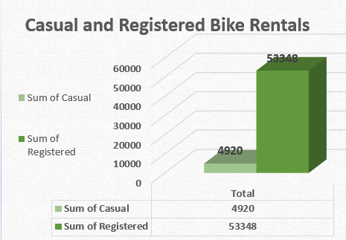
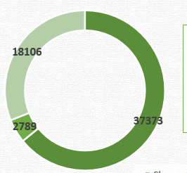
Insights
Casual vs Registered
  The Bike rentals of registered people are more than the casual bike rentals.
  The registered bike rentals are 10 times more than that of casual bike rentals.
  Which indicates that same people like to come again and again to attain the service.
On Weather
  Most of the people prefer travelling in clean weather.
  Light rain is the least preferred which means that people do not like to travel during the rain.

Slide 4
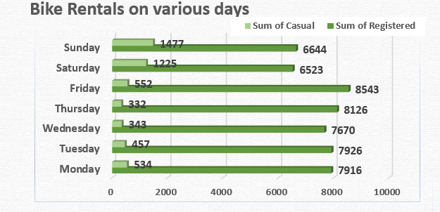
Insights
Various days of week
Registered
  Out of all the days of the week, ”Friday” is when most of the registered people rent the bikes.
  The day when least people take bikes on rent is “Saturday”.
Casual
  Out of all the days of week, “Sunday” is when most of the people take bike on rent for a short period or temporary period of time.
  The day when least people take bike on rent for temporary period is “Thursday
We can conclude that, people may leave their homes to Friday and rent bike on Friday to spend the weekend.

Slide 5
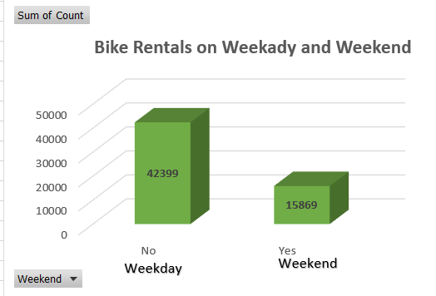
Insights
Weekday vs Weekend
People rent more bikes in weekday than weekend.
Weekday
  Registered= 40,181
  Casual= 2,218
Weekend
  Registered= 13,167
  Casual= 2,705

Slide 6
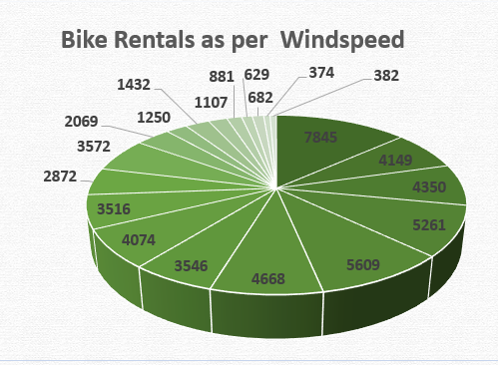
Insights
Windspeed
  Riders or travelers like to travel when there is no windspeed i.e. 0 and the number of bike rentals are 7,845.
  Riders usually avoid renting bikes when the windspeed it to its maximum i.e. 0.28 and the number of bike rentals are 374.
Months
  The data provided was of first and second month only which are January and February respectively.
  More people rented bikes in first month than second.

Slide 7
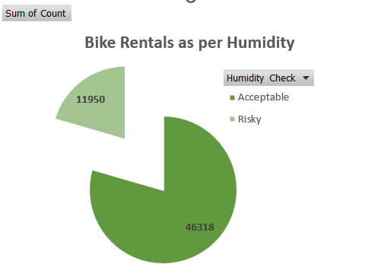
Insights
Humidity
Classification
  Below 70= Acceptable
  Above70= Risky
More people prefer to go during acceptable humidity.
No. of bike rentals in
  Acceptable humidity= 11,950
  Risky humidity= 46,318

Slide 8
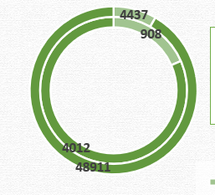
Insights
Temperature
Classification
  <0.1 = Risky
  <0.35 = Safe
  >0.35 = Risky
People prefer to go during the safe temperature and tend to rent bikes.

Slide 9
Conclusion
The registered travels avail more bike rental service than the casual bike rentals.
The number of bike rentals are most on “Friday”.
People prefer to travel in good climate conditions for instance, clean weather, less humidity, less windspeed etc.

Slide 10
Challenges
Using Power query for the first was little challenging because I could not succeed wit first or second try. With the help of Youtube.com I learnt how to merge datasets.
Another challenge was VBA Macros, I recorded the macros for the pre-processing of data but when I tried to implement the same macros in second dataset, the result was not satisfactory. So, I dropped the idea of using it in Dataset 3.
Creating Dashboard was little challenging but I overcome it on my own.

Slide 11
Thank You!

